Slide 1

Session 2: Skills of a Project Manager
Dr Andre Samuel
andre.samuel@sam.edu.tt

Slide 2
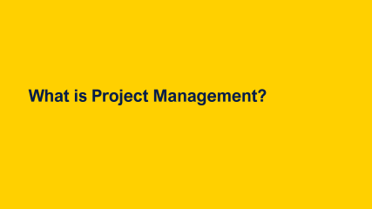

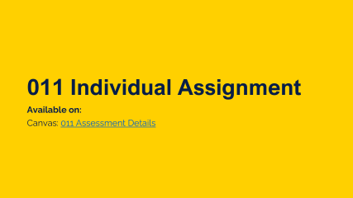
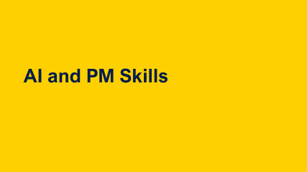
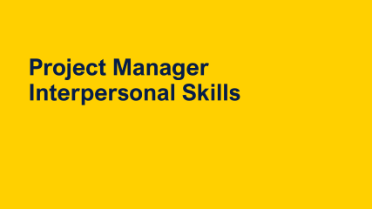
Learning Outcomes

Slide 3
Recap Session 1

Slide 4
Failures and scope creep
PMI’s (2021) survey also revealed:
Project failure rate of 12%
34% of projects experience scope creep – the project getting bigger and bigger -“the uncontrolled expansion to product or project scope, without adjustments to time, costs, and resources.” (PMI, 2021, pp. 249)

Slide 5
Why is project management so important?
Managing projects is difficult, as revealed in PMI’s (2021) Pulse of the Profession global survey, not all projects achieve their outcomes and/or do not succeed in all aspects.…
Remains difficult to manage quality, costs and time

Slide 6
What is a Project?
Characteristics
Temporary
Unique
Progressive Elaboration

Slide 7
Main Project characteristics (Maylor, 2017, pp. 7)
Exact project not been done before
Many aspects of the project have been done before
Impacts people delivering
Impacts people and organisations being delivered to
Detailed requirements may not be known in advance
Project manager has to deal with uncertainty
Delivers benefits
Aspects of uniqueness
Change
Emergence and uncertainty
Mission focused
Project Characteristics
Social construction
Temporary
Integrating
Doesn’t behave like a machine
Involves people and organisations
Team finishes when project finishes
Funding goes with project
Requires interlinking of activities
Requires knowledge and resources to be brought together in a process

Slide 8

Different types of projects
Risk & Uncertainty
Adaptivity & Resilience
High
‘Painting by numbers’
Repetitive operations
Projects
Volume
As …. but ….
Further reading and links
Chapter 1 of Maylor, 2017
Increased risk and uncertainty
Low
Low
Variety
High
First timers
(Maylor, 2017, p. 8)

Slide 9
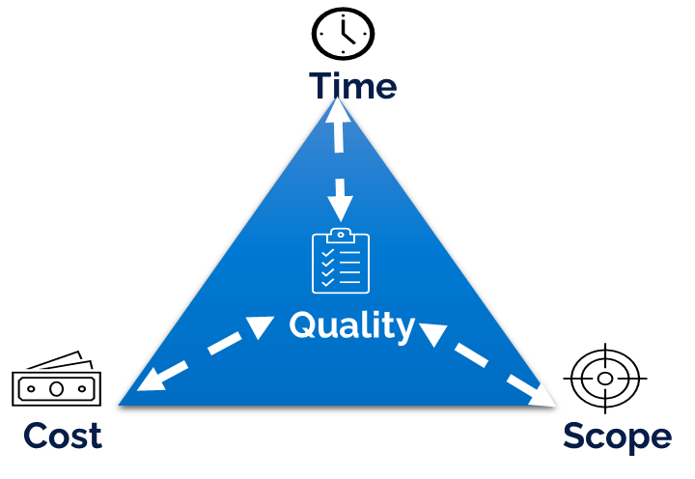
Project Success Criteria- The Triple Constraints
Project Manager’s Responsibility:
to achieve the project objectives
within the project constraints
Iron Triangle
(Atkinson 1999)

Slide 10
Trade Offs
You can have it cheap, you can have it good or you can have it fast.
But you can only have two out of the three

Slide 11

Activity: Beyond the Iron Triangle
Activity
Re-draw the Iron Triangle whilst considering Sustainability as a new constraint.

Slide 12
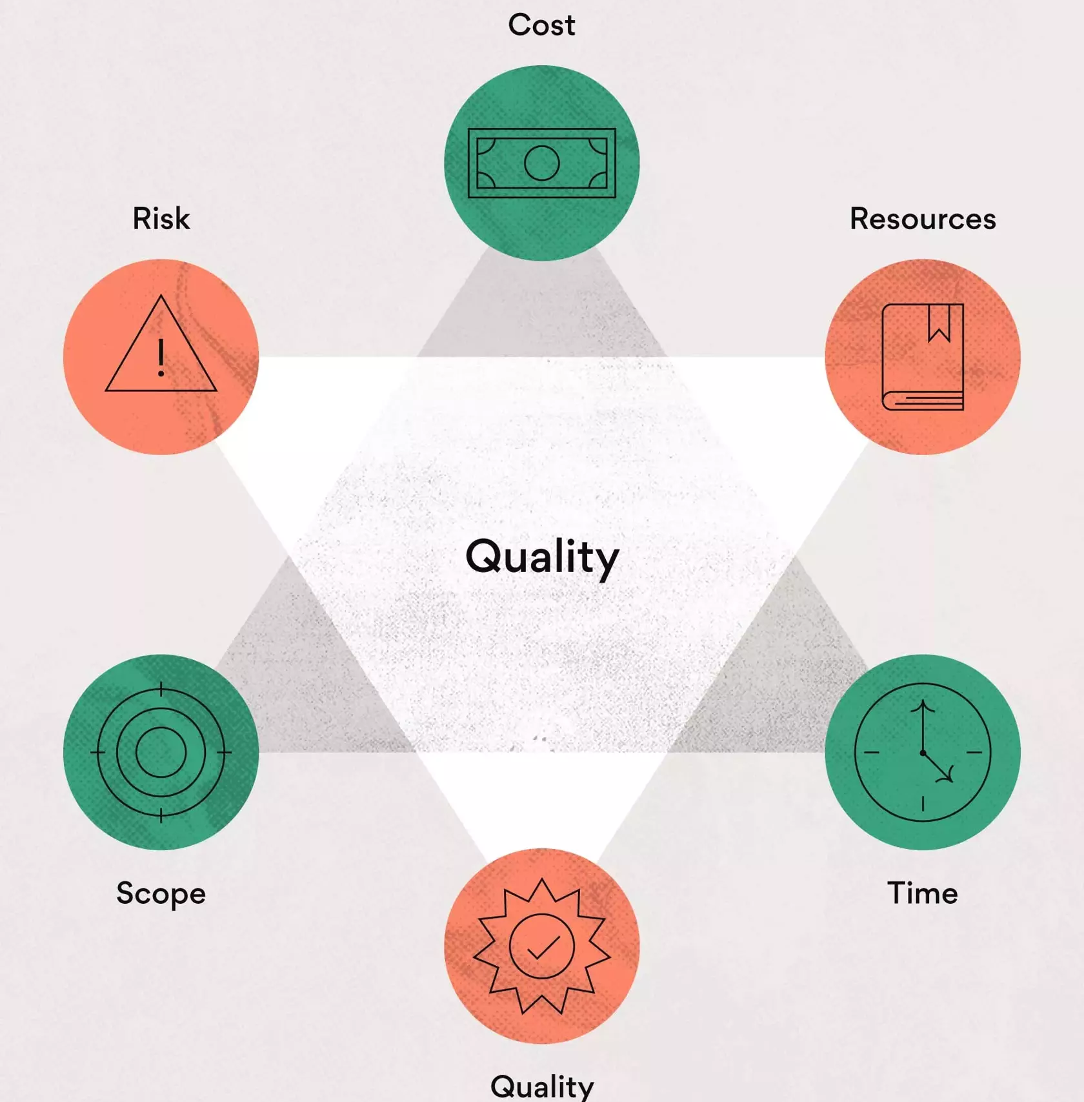
Beyond the Iron Triangle
PMI (2013) Six Constraints in Project Management

Slide 13
What is Project Management?

Slide 14
What is Project Management?
“Project Management is the application of:
knowledge, skills,
tools and techniques
to project activities
to meet project requirements. “ PMI (2000, pg. 6)

Slide 15
Turner (1999, pg. 8) Five Functions of Project-Based Management
PURPOSE (Beneficial Change)
SCOPE
ORGANISATION
TIME
QUALITY
COST

Slide 16
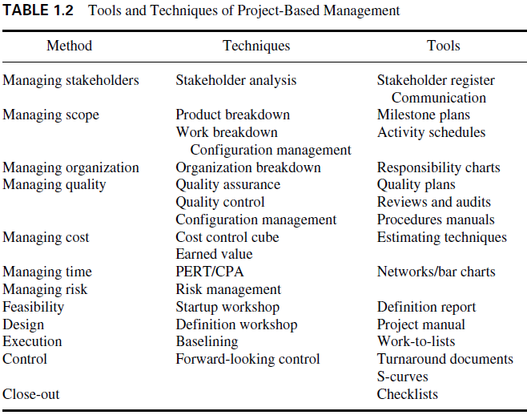
Turner (1999, pg. 24) Tools and Techniques

Slide 17
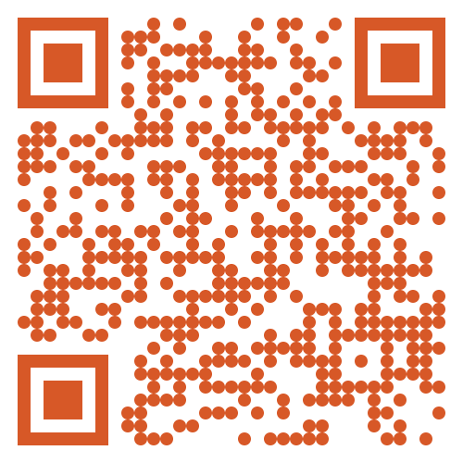
Activity- Tools and Techniques
Have you ever heard of or used any of these tools on past projects?
Go to: https://www.menti.com/al768vdmoe4i

Slide 18
Project Methodology and Lifecyles

Slide 19
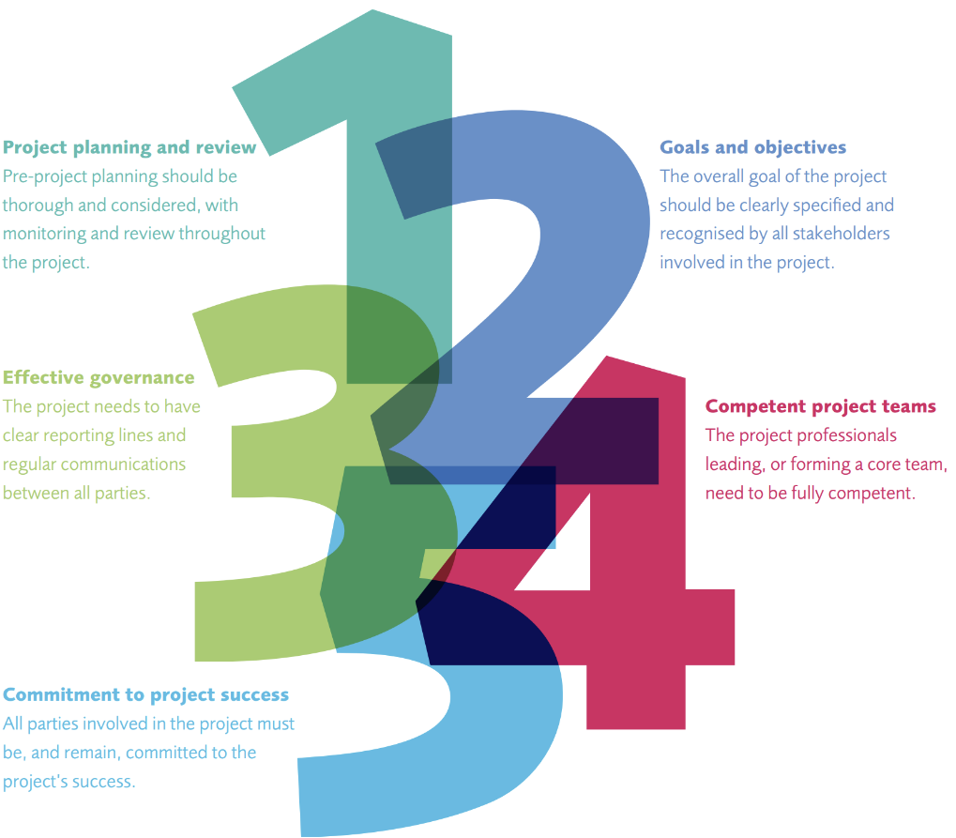
Why do we need a project methodology?
APM’s (2015) Project success research discovered 5 most key factors that make projects successful.
3 of them relate to project management method:
Project planning and review
Goals and objectives
Effective governance
The other 2 relate to skills and commitment
Notes:
Full list of 12:
1. Project planning and review
Pre-project planning should be thorough and considered, with monitoring and review throughout the project.
2. Goals and objectives
The overall goal of the project should be clearly specified and recognised by all stakeholders involved in the project.
3. Effective governance
The project needs to have clear reporting lines and regular communications between all parties.
4. Competent project teams
The project professionals leading, or forming a core team, need to be fully competent.
5. Commitment to success
All parties involved in the project must be, and remain, committed to the project’s success.
Capable sponsors Sponsors play an active role in the life cycle of the project; they assume ultimate responsibility and accountability for the project outcomes.5 Secure funding The project has a secure funding base; contingency funding is recognised from the start and tight control of budgets is in place to ensure maximum value is realised.
Supportive organisations The environment in which the project operates is project-friendly; the organisation provides support and resourcing for project activity (including financing) and access to stakeholders.
End users and operators End users or operators are engaged in the design of the project; the project team engages with users, who are able to take on what the project has produced effectively and efficiently.
Aligned supply chain All direct and indirect suppliers are aware of project needs, schedules and quality standards. Higher and lower tiers of supply chains are coordinated.
Proven methods and tools Good practice project management tools, methods and techniques are applied in a way which maintains an effective balance between flexibility and robustness.
Appropriate standards Quality standards are actively used to drive quality of outputs. Adherence to other standards is regularly monitored in order to ensure delivery is to best practice levels

Slide 20
Why do we need a Project Methodology?
“There’s method to his madness”
Shakespeare-Hamlet
Concepts and Structure
Common methods and rules
Standardize Delivery
Provide a Framework for management
Procedure and steps

Slide 21
Project Management Frameworks and Best Practice
These provide a framework for managing projects:
PMI- PMBoK
Axelos- PRINCE 2

Slide 22
PMI’s PMBoK
Standard and Framework

Slide 23
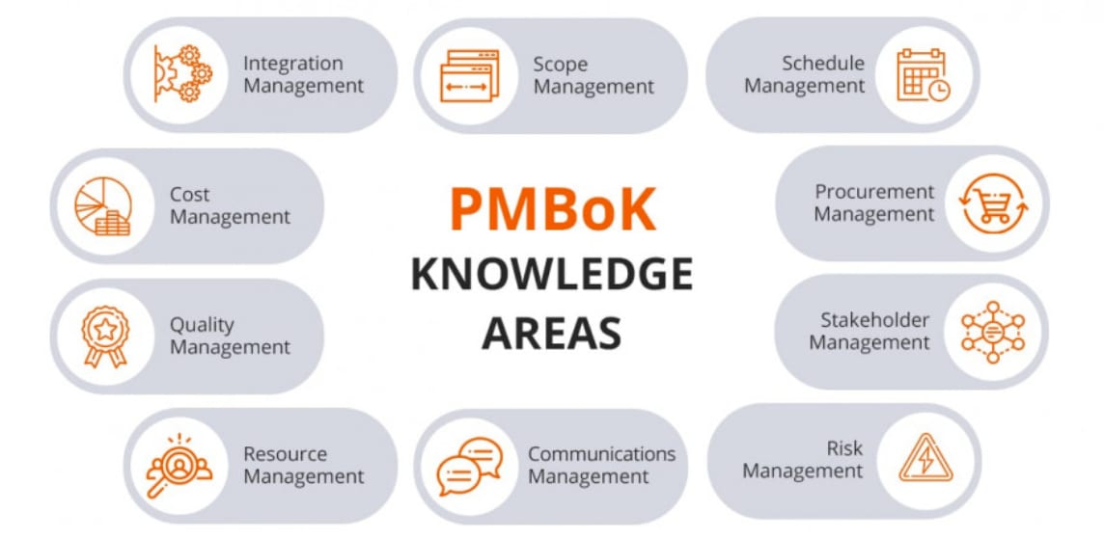
Ten Knowledge Areas PMI (2013, pg. 7)

Slide 24
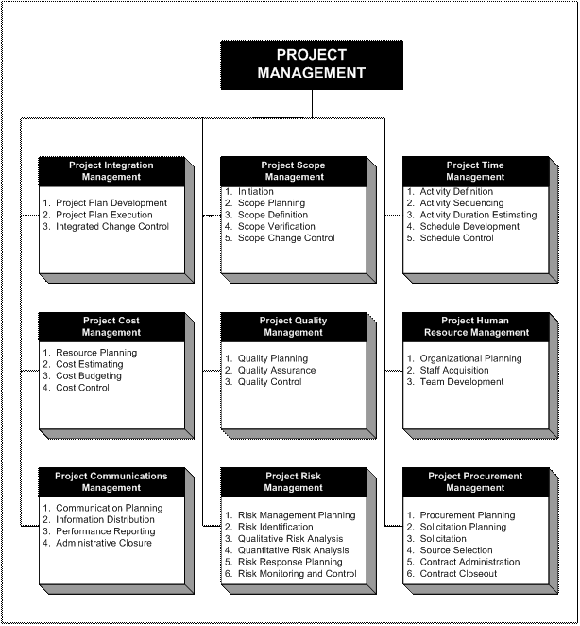
Project Management Processes
PMI (2013)

Slide 25
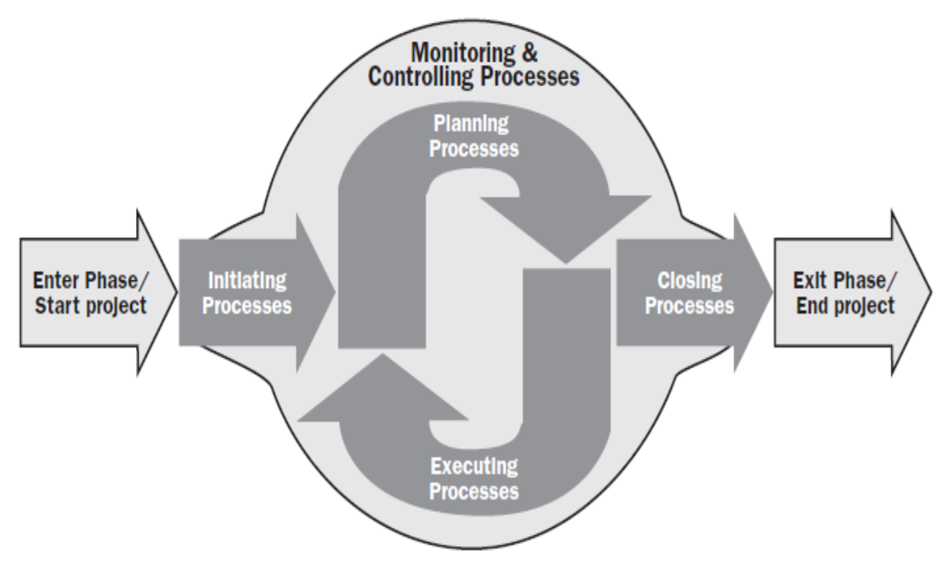
PMI- 5 Process Groups
PMI (2013)

Slide 26
Project Management Processes by Process Groups
Initiating
Planning
Executing
Monitoring and Controlling
Project Close
Why/what is the project
Project charter
Objectives
Team structure
Risks
Stakeholders
Scope
Budget/Costs
Work Breakdown Structure
Gantt chart
Communication plan
Risk management
Direct/manage
Quality management
Team management
Communications
Stakeholders
Status/tracking
Project control
Scope, Cost, Schedule Quality and Resources Control
Risk monitoring
Lessons learnt
Reporting

Slide 27
Axelos PRINCE 2
Methodology

Slide 28
PRINCE 2
PRojects IN Controlled Environments
UK Gov standard
PRINCE – 1989 PRINCE 2 – 1996:
Focus on business justification
Defined organization structure for the project management team
Product-based planning approach
Emphasis on dividing the project into manageable and controllable stages
Flexibility that can be applied at a level appropriate to the project.

Slide 29
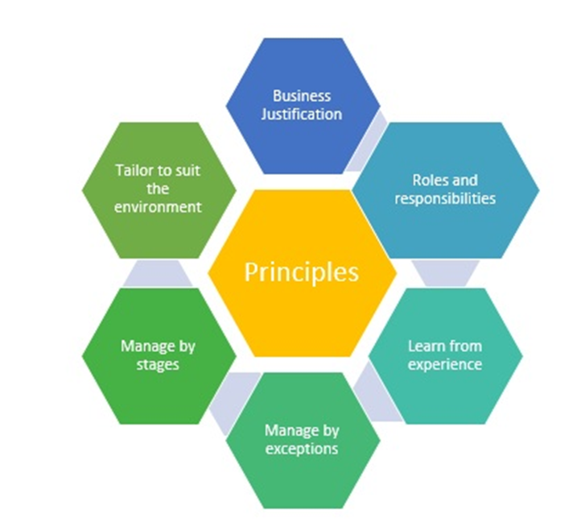
PRINCE 2 Principles
The principles provide a framework of good practice for those people involved in a project
Ensuring that the method is not applied in an overly prescriptive way
But applied in a way sufficient to contribute to the success of the project
So what are these principles?

Slide 30
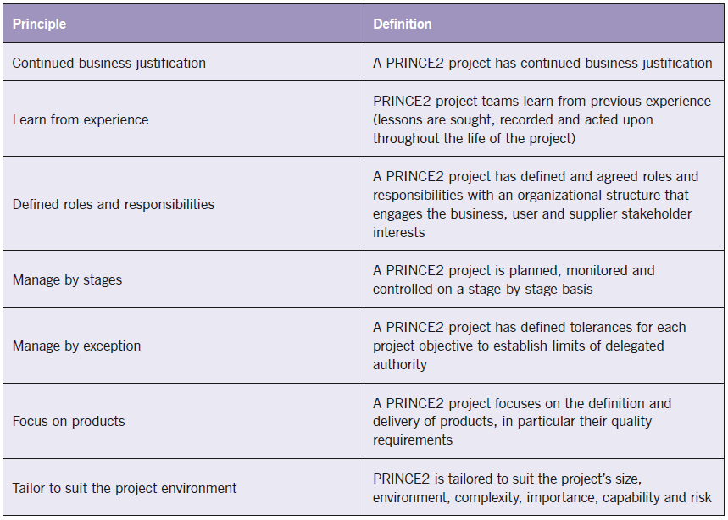
PRINCE 2 Principles
Murray (2011)

Slide 31
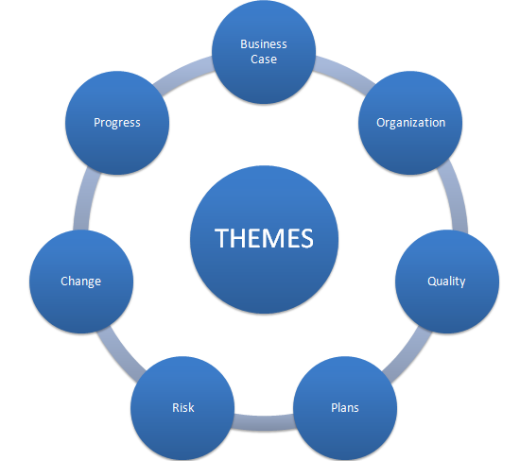
PRINCE 2 Themes
The PRINCE2 themes are those aspects of project management that need to be addressed continually throughout the project lifecycle
They provide guidance on how the process should be performed.

Slide 32
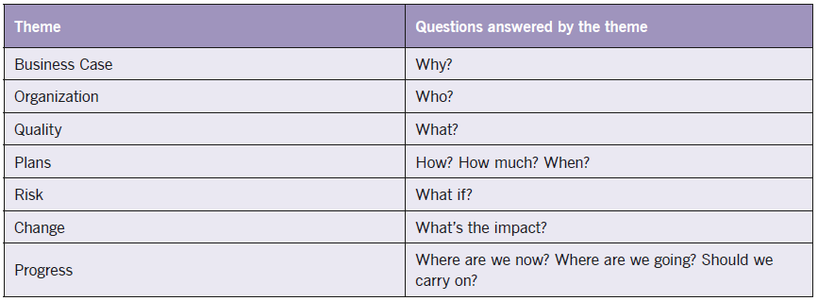
PRINCE 2 Themes

Slide 33
Prince 2 - 7 Processes
PRINCE2 provides a process model for managing a project.
This consists of a set of activities that are required to:
Direct
Manage and
Deliver a project.
An organised and controlled start, i.e. organise and plan before leaping in.
An organised and controlled middle, i.e. keeping projects organised and controlled.
An organised and controlled end, i.e. when you've got what you want and the project has finished, tidy up the loose ends

Slide 34
Prince 2 - 7 Processes
Starting up a project
Directing a project
Initiating a project
Controlling a stage
Managing product delivery
Managing a stage boundary
Closing a project
Pre-project
Initiation stage
Subsequent delivery stage(s)
Final delivery stage
Directing
Managing
Delivering
Directing a Project
Starting up a Project
SB
SB
Closing a Project
Initiating a Project
Controlling a Stage
Controlling a Stage
Managing Product Delivery
Managing Product Delivery
Axelos’s (2017)
SB = Managing a Stage Boundary
Notes:
Royce’s original stages: System requirements, Software Requirements, Analysis, Program Design, Coding, Testing, Operations

Slide 35
Starting up a Project: Covers the pre-project activities required to commission the project ‘Do we have a viable and worthwhile project?’
Directing a Project: Describes the Project Board’s activities in exercising overall project control.
Initiating a Project: Describes the activities the Project Manager must lead in order to establish the project on a sound foundation

Slide 36
Managing a Stage Boundary: Describes the activities the Project Manager must undertake to provide the Project Board with sufficient information to enable it to review the success of the current stage, approve the next Stage Plan
Controlling a Stage: Describes how the Project Manager manages the project execution/delivery activity during a stage, and reports progress and exceptions to the Project Board

Slide 37
Managing Product Delivery: Addresses the Team Manager’s role in supervising the detailed work of creating the project’s products
Closing a Project: Describes the closure activity towards the end of the final stage of the project

Slide 38
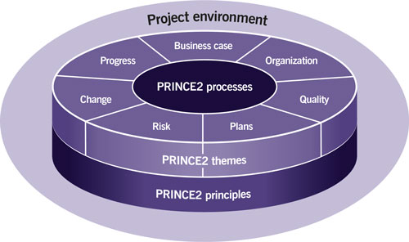

PRINCE 2- summary
Axelos - What is PRINCE2®?

Slide 39
Project Manager Interpersonal Skills

Slide 40
PM Knowledge Skills and Competencies
Project managers accomplish work through the project team and other stakeholders
Effective project managers acquire a balance of:
Technical,
Interpersonal/Human
Conceptual skills
(PMI 2021)

Slide 41
PM Interpersonal Skills PMI (2021)
Leadership
Team building
Motivation
Communication
Influencing
Decision making
Political and cultural awareness
Negotiation
Trust building
Conflict management
Coaching

Slide 42
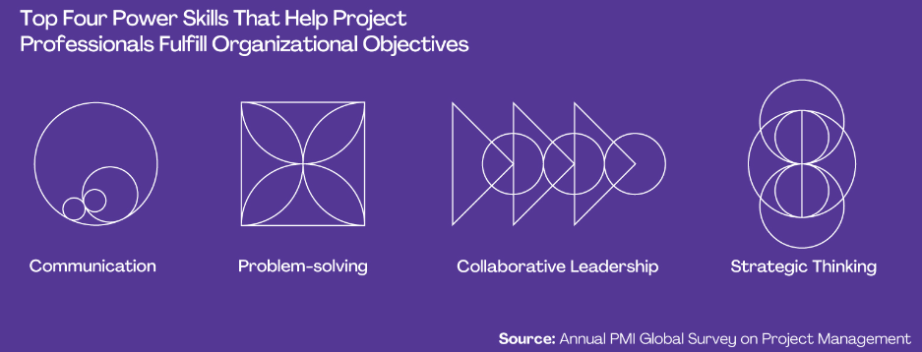
What Are Power Skills?
PMI (2022) defines power skills as abilities and behaviors that facilitate working with others and help project professionals to succeed in the workplace.
Some individuals and other organizations also refer to them as “soft skills” or “interpersonal skills.”
PMI 2022

Slide 43
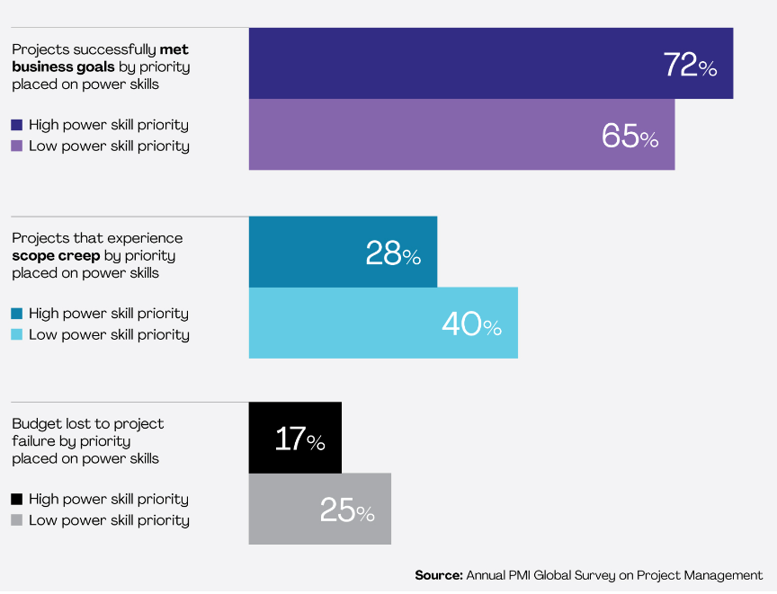
The Relationship Between Power Skills and Project Success
PMI 2022

Slide 44

Further Skills Required by PM APM (2019)
The Golden Thread Report identified:
Budgeting/cost control and financial management
Planning and monitoring
Strategic management
Leadership and management
Risk/issue and opportunity management
Digital skills
Project management qualifications
Breadth/diversity of thinking
Coaching and mentoring
Stakeholder management and communications

Slide 45
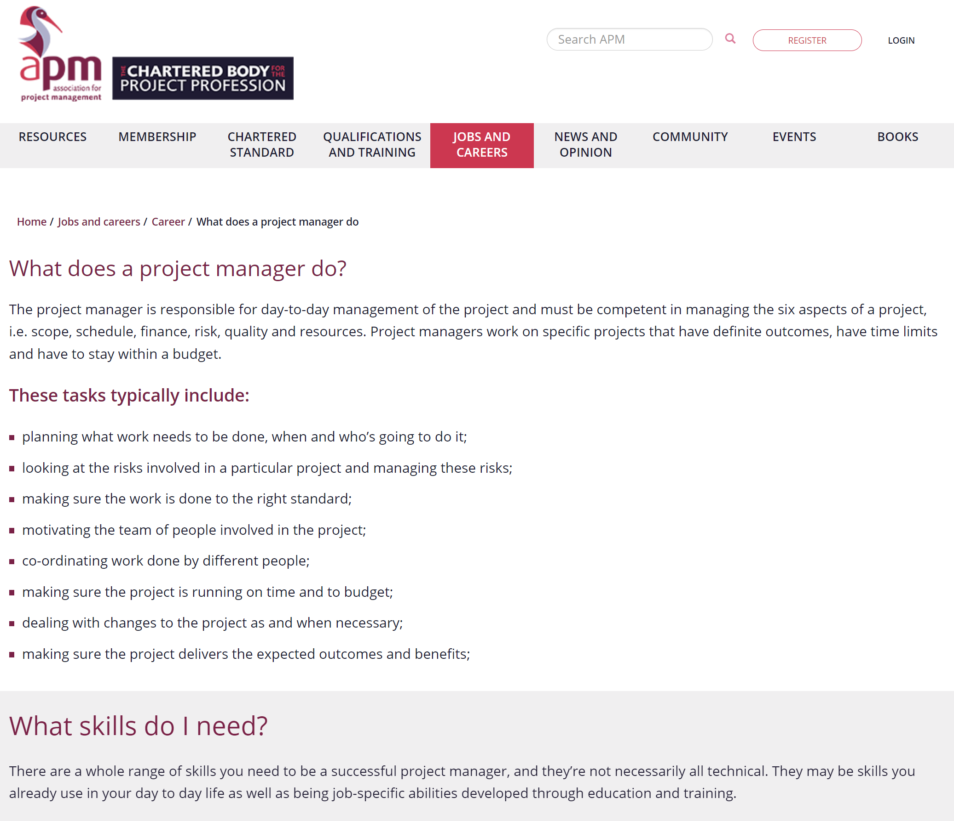
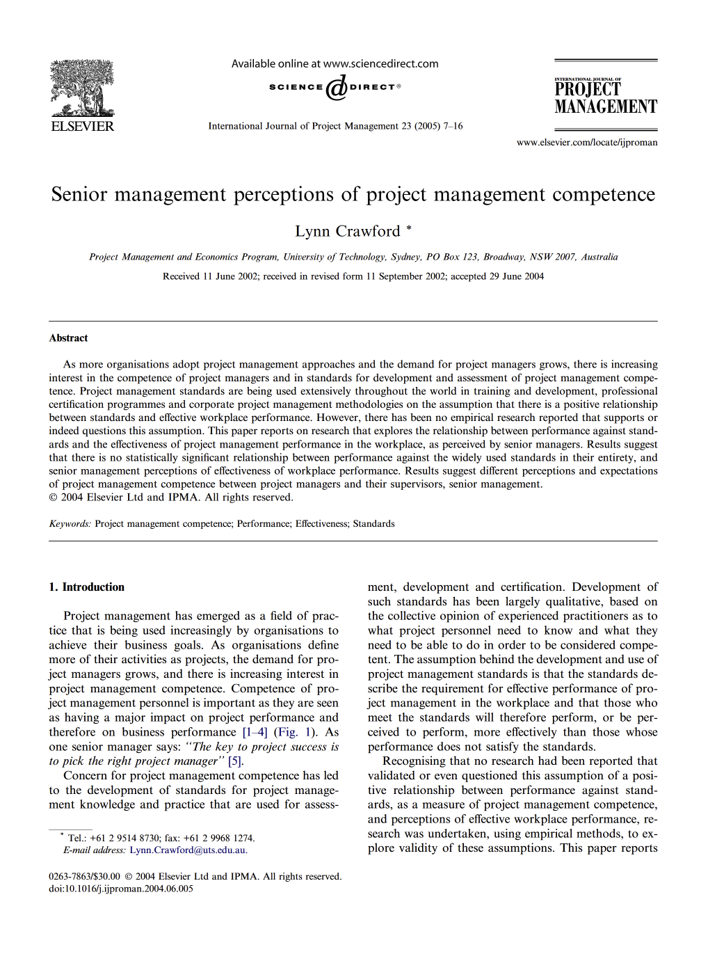
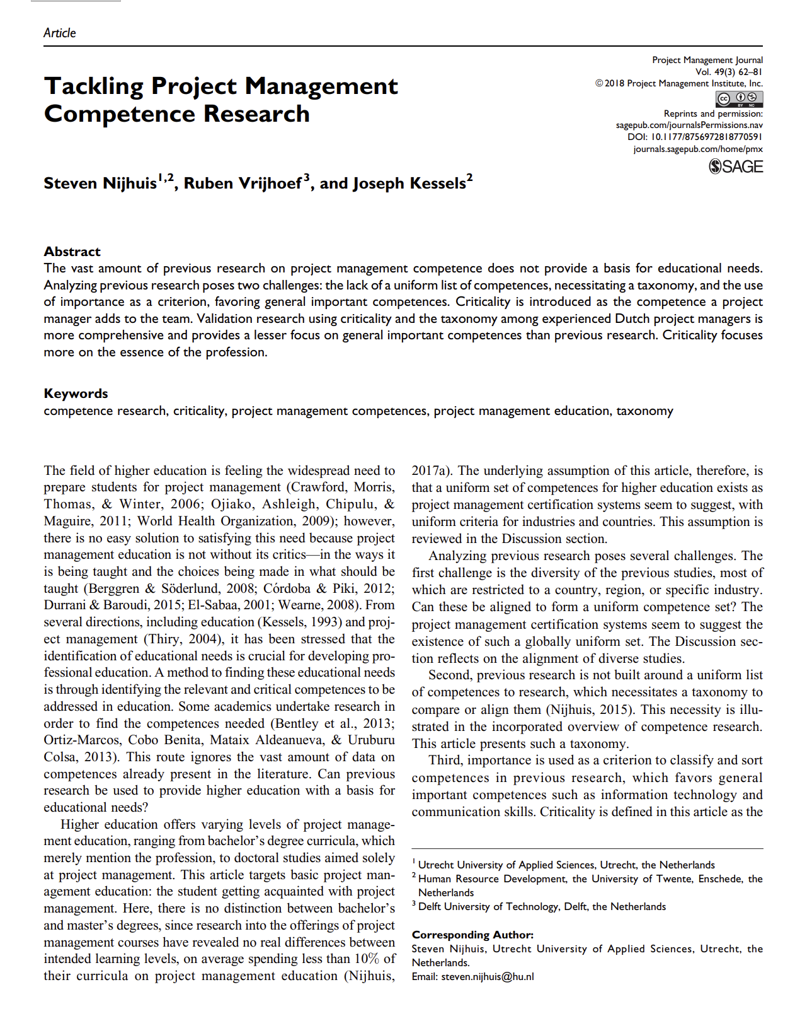
Further Reading- Are there other skills?
Tip! Scan the article to find the skills list – you don’t need to read the whole article
Association for Project Management (2021) What does a Project manager do?
HINT!, consider the list of tasks
Association for Project Management (2019) The Golden Thread: A study of the contribution of project management and projects to the UK''s economy and society – HINT!, see page 20
Nijhuis et al (2018) Tackling Project Management Competence Research – HINT!, see page 68 (lit review competence list and Figure 5 results from focus group on page 70 – overwhelming list, but not all considered important!)
Crawford (2005) Senior management perceptions of project management competence
HINT!, see page 9 for the model of competencies
Notes:
The Golden Thread - Insights from extensive research via literature review, interviews, desk-based research using surveys, online survey, etc.
Involved 428 organisations in the UK
Tackling Project Management Competence Research – Dutch study started with a literature review to identify competencies, then ran focus groups to prioritise competencies

Slide 46
Activity- Skill Reflection
What do you think of your own current skill set?
What experience do you already have?
Reflect on one skill. Give yourself a score (1-5)
Project Management Skills | Did you have this skill (before the module)? Yes No | If YES score 1 - 5 (with 1 being less skilled and 5 being most skilled) How can you evidence this skill?
Risk and uncertainty management | Yes | 2.5 As a member of my rowing team, I organised a trip and completed a risk assessment form. However, none of the risks occurred so I did not have to take any actions/manage that.

Slide 47
Evaluating Your skill Set
You can adapt and use the template for Part 1 of 011 Assignment
Project Management Skills | Did you have this skill (before the module)? Yes No | If YES score 1 - 5 (with 1 being less skilled and 5 being most skilled) How can you evidence this skill?
Risk and uncertainty management | Yes | 2.5 As a member of my rowing team, I organised a trip and completed a risk assessment form. However, none of the risks occurred so I did not have to take any actions/manage that.

Slide 48
AI and PM Skills

Slide 49
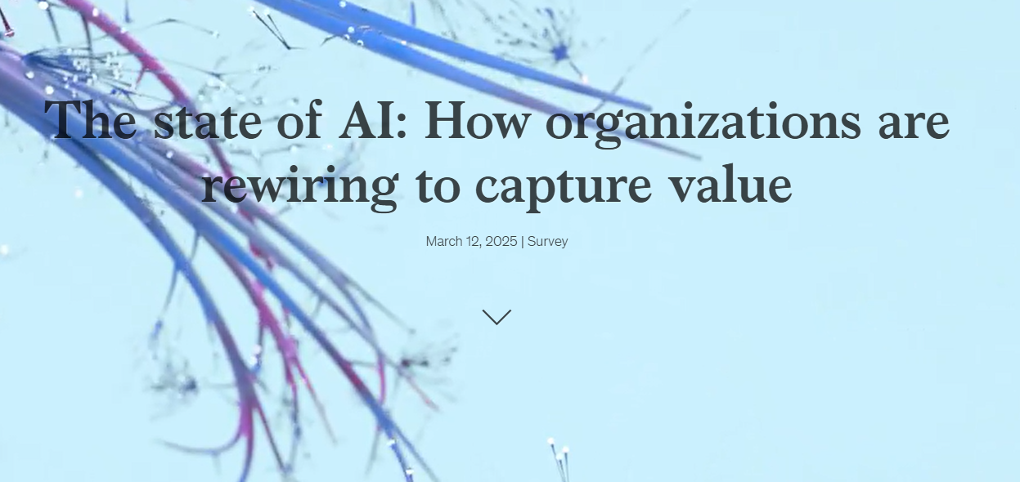
Explosive Growth of AI
https://www.mckinsey.com/capabilities/quantumblack/our-insights/the-state-of-ai-how-organizations-are-rewiring-to-capture-value

Slide 50
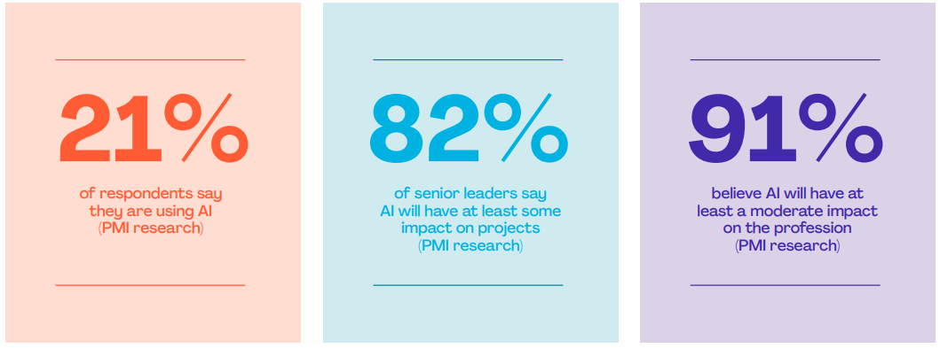
Project Management With AI (PM-AI)
PMI (2023) Shaping the Future of Project Management With AI

Slide 51
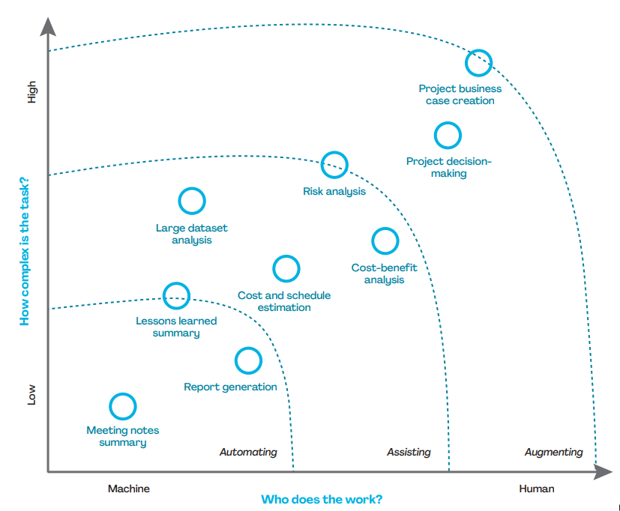
Support GenAI can provide for specific project tasks
PMI (2023) Shaping the Future of Project Management With AI

Slide 52
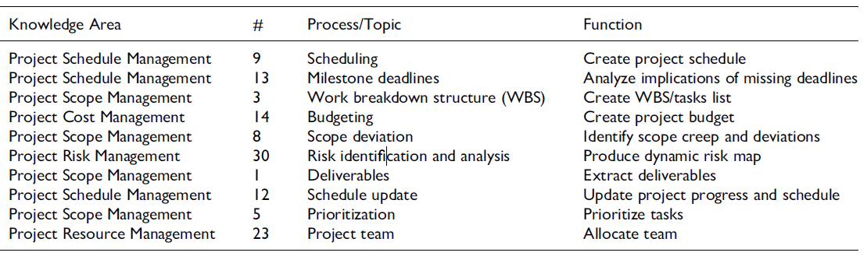
AI in Project Management
Holzmann et al 2022

Slide 53
Implications of AI for Project Management
AI-powered tools will take over administrative tasks for project managers
AI tools can analyze data from current and previous projects to provide insights
Cost-benefit analyses of different options; or integration of current economic conditions into expected returns
Reporting, updating project plans based on changes to resources’ availability
PMI (2021)
Chamorro-Premuzic and Boyce (2023)

Slide 54
6 Aspects of Project Management that Will Be Disrupted
Better Monitoring of Progress
Anticipate Risks and Issues
Automated Project Reports
Better selection of Project Methodology
Compliance monitoring
Automate project support functions
Nieto-Rodriguez and Vargas (2023) How AI Will Transform Project Management

Slide 55
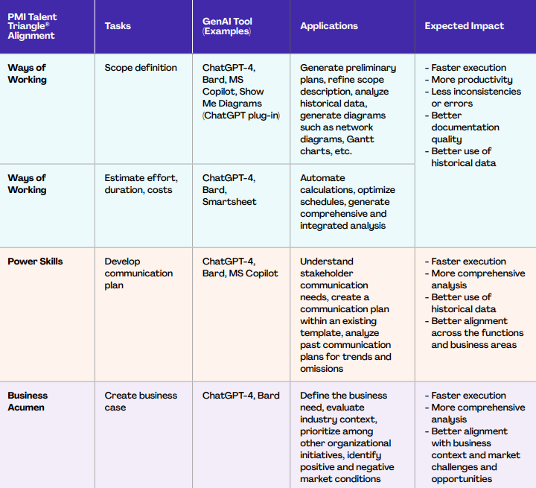
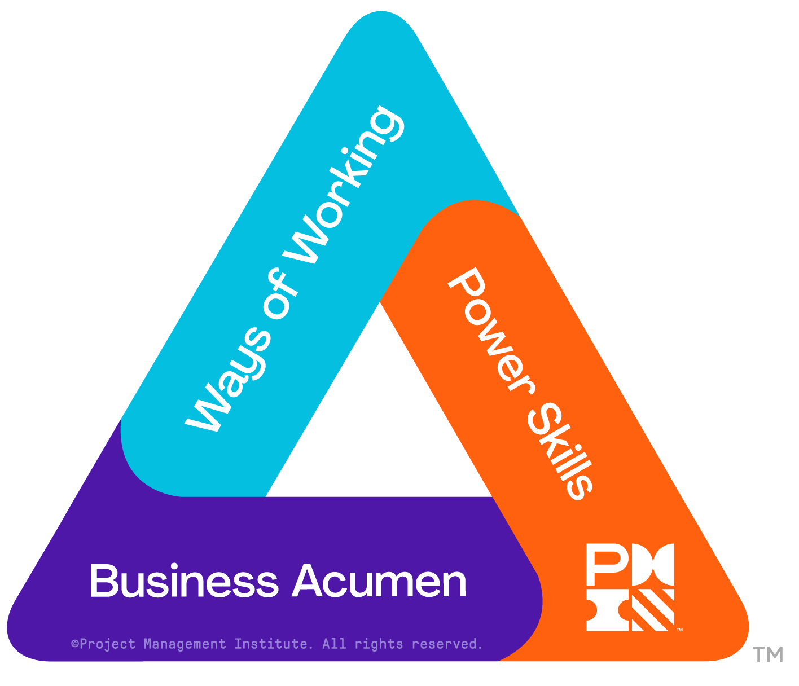
AI Skills and Tools for Project Managers
PMI Talent Triangle
PMI (2023) Shaping the Future of Project Management With AI

Slide 56
Activity- Jeopardy

Slide 57
011 Individual Assignment
Available on:
Canvas: 011 Assessment Details

Slide 58
Part 1 Skills of a Project Manager and me (25%)
Approx. 1000 words, not including any tables [learning outcomes: LO1; LO2; LO4]
1.1 Knowledge and Skills needed to be a successful project manager (complete within the first 3 weeks of the module) Discuss the different knowledge and skills, this should include both the soft skills (e.g. team work, management leadership, communication, etc.) organisational skills and technical skills (e.g. use of software and AI) required to manage projects, using appropriate reference to support your discussion. Consider the various skills discussed in the first 2-3 weeks of the module to develop a table of required knowledge and skills.

Slide 59
1.2 Reflection of your knowledge, skills and competencies at the beginning of the module (complete within the first 3 weeks of the module) and at the end of the module
At the beginning: Critically analyse your current abilities (at the beginning of the module) , in relation to the knowledge and skills identified in the part 1.1 and the results of your Belbin team roles questionnaire. Underpin the analysis with reflection(s) on previous project experience. Complete continuing professional development (CPD) analysis with reflection(s) on previous project experience using a table or planner.
At the end of the module: Conclude this part reflecting on what you have learnt in terms of knowledge and skills, including soft skills, organisational skills and technical skills. Reflect on the feedback from your Study Buddies team and any other team work you have taken part in outside of the module. [Optional] You may consider providing a visual representation of your analysis. For example, by providing a scorecard/bar chart outlining your evaluation of your ability at the beginning and end of the module.

Slide 60
For Part 1.2- Reflection before and after module
You can adapt and use the template
Copy and Paste into Word Document
Project Management Skills | Did you have this skill (before the module)? Yes No | If YES score 1 - 5 (with 1 being less skilled and 5 being most skilled) How can you evidence this skill? | Did you improve in this skill by the end of the module? | End of module score 1 - 5 (with 1 being less skilled and 5 being most skilled)

Slide 61
Self-managed Study
Read Chapters 2 and 3 of Maylor
Have a go at the practice quiz
Start your 011 Individual Assignment
Part 1 - Reflection on Your Project Management Knowledge and Skills (15%)

Slide 62
References
Belbin, R.M. 1993. Team roles at work. Oxford: Butterworth-Heinemann
Finn, J.D., Pannozzo, G.M., and Achiles, C.M. 2003., The ‘why’s’ of class size: student behaviour in small classes. Review of Educational Research, 73(3): ,321-368
Janis, Irving (1982). Groupthink. Houghton Mifflin Company.
Katzenbach, J. R., & Smith, D. K. (1993). The wisdom of teams: Creating the high-performance organization. Boston, Mass: Harvard Business School Press.
Lencioni, P. 2002, The Five Dysfunctions of a Team, Jossey-Bass
Lock, D. (2007) Project Management, 9th edition, Gower, England
Project Management Institute, 2021. A Guide to the Project Management Body of Knowledge, PMBOK Guide 6th ed. Newton Square, Pennsylvania: Project Management Institute Inc.
Tuckman, B.W. 1965. Developmental sequences in small groups. Psychological Bulletin, pp. 384-399.. The article was reprinted in Group Facilitation: A Research and Applications Journal ‑ Number 3, Spring 2001 and is available as a Word document: http://dennislearningcenter.osu.edu/references/GROUP%20DEV%20ARTICLE.doc.
West, M.A., 2012. Effective Teamwork (3rd Edition). London: Blackwell.
West, M.A., and Lyubovnikova, J., 2012., Real teams or pseudo teams? The changing landscape needs a better map. Industrial and Organizational Psychology. 5: 25-55.

